Slide 2


Mars OS
Rutwik Stuff Corp.

Slide 3
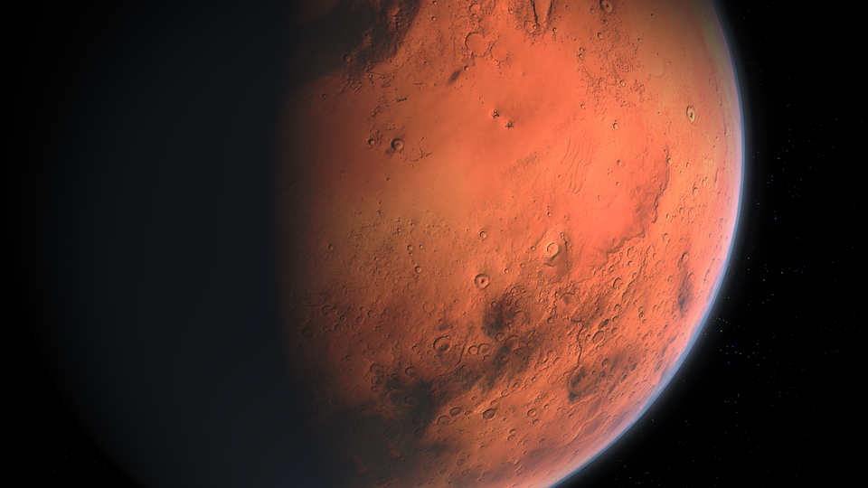
Mars OS
Install
Repair your computer
Rutwik Stuff Corp.

Slide 4

Mars OS
We are currently repairing your PC, it should take about 5 minutes.
Repairing PC
Rutwik Stuff Corp.

Slide 5
Mars OS 1.0 Setup
Choose the language of your installation
English
English (US)
US
Continue
Rutwik Stuff Corp.

Slide 6
Setup is starting

Slide 7
Mars OS 1.0 Setup
Enter your product key to activate Mars OS
Continue
I don’t have a product key
Rutwik Stuff Corp.

Slide 8
Mars OS 1.0 Setup
WARNING: If you don’t activate Mars OS, then you will be using unlicensed software, please activate Mars OS within 30 days. (This popup will close in 5 seconds)
Rutwik Stuff Corp.

Slide 9
Mars OS 1.0 Setup
WARNING: If you don’t activate Mars OS, then you will be using unlicensed software, please activate Mars OS within 30 days. (This popup will close in 4 seconds)
Rutwik Stuff Corp.

Slide 10
Mars OS 1.0 Setup
WARNING: If you don’t activate Mars OS, then you will be using unlicensed software, please activate Mars OS within 30 days. (This popup will close in 3 seconds)
Rutwik Stuff Corp.

Slide 11
Mars OS 1.0 Setup
WARNING: If you don’t activate Mars OS, then you will be using unlicensed software, please activate Mars OS within 30 days. (This popup will close in 2 seconds)
Rutwik Stuff Corp.

Slide 12
Mars OS 1.0 Setup
WARNING: If you don’t activate Mars OS, then you will be using unlicensed software, please activate Mars OS within 30 days. (This popup will close in 1 seconds)
Rutwik Stuff Corp.

Slide 13
Mars OS 1.0 Setup
Accept the Mars OS Terms
Accept
Mars OS 1.0 Terms of Service
Mars OS is property of Rutwik Stuff Corp. If you try to make any clone of this operating system, you will be fined, so please do not steal any branding that was used to make Mars OS 1.0
Deny
Rutwik Stuff Corp.

Slide 14
Mars OS 1.0 Setup
Select your installation type
Upgrade
Custom
Rutwik Stuff Corp.

Slide 15

Mars OS 1.0 Setup
Select a drive to install Mars OS 1.0
Disc 1 SSD
1TB
Disc 2 SSD
900GB
Continue
Rutwik Stuff Corp.

Slide 16
Mars OS 1.0 Setup
That’s all we need for now, Installing Mars OS
Copying Mars OS files
Rutwik Stuff Corp.

Slide 17
Mars OS 1.0 Setup
That’s all we need for now, Installing Mars OS
Copying Mars OS files
Rutwik Stuff Corp.

Slide 18
Mars OS 1.0 Setup
That’s all we need for now, Installing Mars OS
Copying Mars OS files
Rutwik Stuff Corp.

Slide 19
Mars OS 1.0 Setup
That’s all we need for now, Installing Mars OS
Installing Mars OS files
Rutwik Stuff Corp.

Slide 20
Mars OS 1.0 Setup
That’s all we need for now, Installing Mars OS
Installing Mars OS files
Rutwik Stuff Corp.

Slide 21
Mars OS 1.0 Setup
That’s all we need for now, Installing Mars OS
Installing Mars OS files
Rutwik Stuff Corp.

Slide 22
Mars OS 1.0 Setup
That’s all we need for now, Installing Mars OS
Optimizing Mars OS
Rutwik Stuff Corp.

Slide 23
Mars OS 1.0 Setup
That’s all we need for now, Installing Mars OS
Optimizing Mars OS
Rutwik Stuff Corp.

Slide 24
Mars OS 1.0 Setup
That’s all we need for now, Installing Mars OS
Optimizing Mars OS
Rutwik Stuff Corp.

Slide 25
Mars OS 1.0 Setup
That’s all we need for now, Installing Mars OS
Optimizing Mars OS
Rutwik Stuff Corp.

Slide 26
Mars OS 1.0 Setup
That’s all we need for now, Installing Mars OS
Optimizing Mars OS
Rutwik Stuff Corp.

Slide 27
Mars OS 1.0 Setup
That’s all we need for now, Installing Mars OS
Restarting PC
Rutwik Stuff Corp.

Slide 28
Mars OS 1.0 Setup
That’s all we need for now, Installing Mars OS
Restarting PC
Rutwik Stuff Corp.

Slide 29
Mars OS 1.0 Setup
That’s all we need for now, Installing Mars OS
Restarting PC
Rutwik Stuff Corp.

Slide 30
Mars OS 1.0 Setup
That’s all we need for now, Installing Mars OS
Restarting PC
Rutwik Stuff Corp.

Slide 31
Mars OS 1.0 Setup
That’s all we need for now, Installing Mars OS
Restarting PC
Rutwik Stuff Corp.

Slide 32
Mars OS 1.0 Setup
That’s all we need for now, Installing Mars OS
Restarting PC
Rutwik Stuff Corp.

Slide 34
Mars OS
Rutwik Stuff Corp.

Slide 35
Mars OS 1.0 Setup
Sign in to your Rutwik Account
Enter your email here
Forgot Password
Create Account
Continue
Use without account
Rutwik Stuff Corp.

Slide 36
Mars OS 1.0 Setup
Continue
Rutwik Stuff Corp.

Slide 37
Continue
Rutwik Stuff Corp.

Slide 38
Continue
Rutwik Stuff Corp.

Slide 39
Continue
Mars OS 1.0

Slide 40

Admin
Sign in
Mars OS 1.0

Slide 41







Trash
About
Firefox
This PC
OneNote
5:31pm
11/25/2023

Slide 42


OneNote
Trash
About
Firefox
About
Firefox
This PC
Volume
45%
OneNote
Admin
5:31pm
11/25/2023

Slide 43
X
Trash
About
Mars OS 1.0
Firefox
This version of Mars OS was created by Rutwik Stuff Corp.
This software is not activated, please Activate Here
This PC
OneNote
5:31pm
11/25/2023

Slide 44
OneNote
Trash
About
Firefox
About
Firefox
Search for something
This PC
Volume
45%
Shut Down
OneNote
Restart
Admin
5:31pm
11/25/2023

Slide 46
Mars OS
Rutwik Stuff Corp.

Slide 47
Admin
Sign in
Mars OS 1.0

Slide 48
Shutting Down
Mars OS 1.0

Slide 49
It is now safe to turn off your computer.
[Turn on]

